Slide 1
RUNGTA COLLEGE OF DENTAL SCIENCES & RESEARCH
Introduction to Surgery, Principles of Surgery and Sterilization.
DEPARTMENT OF GENERAL SURGERY

Slide 2
Specific learning Objectives
At the end of this presentation the learner is expected to know ;
Core areas* | Domain ** | Category #
Introduction to Surgery | Cognitive | Must Know
Principles of Surgery | Cognitive | Must Know
History of Surgery | Cognitive | Need to Know
Sterilization | Cognitive | Must Know

Slide 3
Table of Content
Definition and specialities of surgery
History of Surgery
Ancient period
Medieval period
Modern period
Sterilisation and Disinfection
Physical agents
Chemical agents
Autoclaving
Gases
Surface-active agents
Surgical Principles

Slide 4
DEFINITION
Surgery is a branch of medical science in
which hands or instruments or both are
used and maneuvered for the purpose of
diagnosis or treatment of an injury or
disease.
Surgery may be needed for
Repair
Resection or
Reconstrction of the body parts.

Slide 5
VARIOUS SPECIALITIES IN SURGERY
1. General surgery
2. Cardio-thorasic surgery.
3. Neurosurgery
4. Orthopedic surgery.
5. Dentistry.
6. Eye or ocular surgery
7. Spinal surgery.
8. Cosmetic and Burn surgery .
9. Onco-surgery
10.Leproscopic surgery
11.Robotic surgery etc and
many more-…….

Slide 6
QUALITIES IN A SURGEON
1. Lion’s heart
2.Eagle’s eye
3.Ladies hand
OTHERS-
Affability. ...(friendly,sympathetic)
Dexterity. ...(skill in performing task with hands)
Sound Judgment. ...
Compassion.
Ethical practices
Regular updates his knowledge
Patience & confidence
Artistic vision and
Body stamina

Slide 7
Intelligence,
professionalism,
conscientiousess,
creativity,
courage, and perseverance
Becoming a good surgeon is a lifelong process.
***

Slide 8
HISTORY OF SURGERY
History of surgery can be described in 3 part.
1.Ancient-
* Sushrut in India-Specially known for
plastic surgery of ear & nose.
* Hippocrates in Greece & Rome,he is also
known as Father of Medicine.
* In Egypt -Knowledge about wound ,taking
case history & triphination were known to
them.King Hammurabi laid code of conduct.

Slide 9
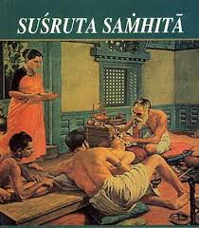
SOME IMPORTANT PERSON WHO CONTRIBUTED IN SURGERY

Slide 10
Susruta of ancient india (1500-BC) has described more than 100 surgical instrument and he is best known for plastic surgery of nose and ear.
Hippocrates (450-350BC) has written books on fractures,dislocations and surgical disorders.He is best known as Father of Medicine & surgery.

Slide 11
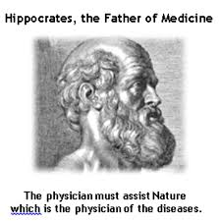

Slide 12
HIPPOCRATE’S
0ATH

Slide 13
I swear to fulfill, to the best of my ability and judgment, this covenant:...
I will respect the hard-won scientific gains of those physicians in whose steps I walk, and gladly share such knowledge as is mine with those who are to follow.
I will apply, for the benefit of the sick, all measures which are required, avoiding those twin traps of overtreatment and therapeutic nihilism.
I will remember that there is art to medicine as well as science, and that warmth, sympathy, and understanding may outweigh the surgeon's knife or the chemist's drug.
I will not be ashamed to say "I know not," nor will I fail to call in my colleagues when the skills of another are needed for a patient's recovery.
I will respect the privacy of my patients, for their problems are not disclosed to me that the world may know. Most especially must I tread with care in matters of life and death. Above all, I must not play at God.

Slide 14
I will remember that I do not treat a fever chart, a cancerous growth, but a sick human being, whose illness may affect the person's family and economic stability. My responsibility includes these related problems, if I am to care adequately for the sick.
I will prevent disease whenever I can, for prevention is preferable to cure.
I will remember that I remain a member of society, with special obligations to all my fellow human beings, those sound of mind and body as well as the infirm.
If I do not violate this oath, may I enjoy life and art, respected while I live and remembered with affection thereafter. May I always act so as to preserve the finest traditions of my calling and may I long experience the joy of healing those who seek my HELP.
**

Slide 15
2.Medieval period-
During this period,surgery had a decline.It was due to growing Buddhism and the massage of non-violence.Many people lebelled surgery as aasuri medicine.
However, in Arab, Muslims entered in field of medicine.
They made contribution by building big hospitals.
In Spain,treatment of empyema,pericarditis and hysterectomy were done first time.

Slide 16
3.Modern era-
During 15th century and after that tremendous
development was seen in surgery and it is still continuing . New techniques and new development in other branches of science made this possible.Use of new diagnosis technique i.e. CT scan, USG, MRI & radiodiagnosis,all made surgery easy and acceptable.

Slide 17
CELSUS- He described inflammation and wrote a
book.
AMBROISE PARE a french surgeon ,very popular in
1600th century.
ANDREAS VESALIUS-(1514-1564)-He was the first to say that dissection on human body is must for anatomy knowledge.
JOHN HUNTER(1728-1793)-superb anatomist and teacher, known as Father of experimental surgery

Slide 18
Joseph Lister (1827-1912)-He was the originator of antisepsis in surgery.He also made surgeon to wear clean gloves and wash hands before the operation.He is known as founder of Antiseptic Surgery.
Louis pasteur(1895)-A french scientist,brought the germ theory of diseases.Pasteurization of milk was a land mark concept.
Landsteiner(1929) made the discovery of blood group,which helped in further development of blood banks which helped in surgery.

Slide 19
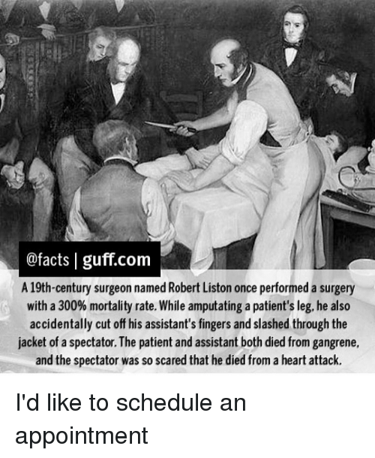

Slide 20
W.k.Rontgen- discovered x-rays in 1895.
Alexander Flaming- invented Penicillins an antibiotic.
Michael Debakey (1964)- did extensive work on cardiothorasic surgery and first time successful use of Sephenous vein in coronary artery bipass graft surgery.
Christian Bernard (SA) 1967- did first successful heart transplant operation
*******.

Slide 21
PROCEDURE OF A PATIENT UNDERGOING
SURGERY
1.Admission-
Patient requiring general anesthesia or local
regional anesthesia is admitted 1-2 days prior
to surgery. It helps in-
* To assess fitness of patient.
* To provide adequate pre-operative care
* Medication to control his other illness.
2.In the ward-
* Proper history taking of patient.
* Proper physical & systemic examination.
* If require ,examination by other specialist,anesthetist
* Intravenous saline infusion/ blood transfusion

Slide 22
Introduction to various surgical principle
Every aspect of surgery has important role right from
1. selection of patient ,
2. pre-operative assessment,
3. surgical procedure to
4. post operative care.

Slide 23
3.Premedication-
* To relieve anxiety & worries
* atropine given to minimize secretion in
patients planned for G.A.
4.In operation theatre-
* Anesthesia by anesthetist
* Surgeon and other assisting staff will
scrub their hands and wear head and face
mask and body gown.
* the site is cleaned & sterlised.
* Entire body is covered except surgical site.
* Surgical proceedure is carried out.
* After operation,when the haemodynamics are stables,
patient is shifted to ward.

Slide 24
5.In the ward-
* Watch for post-operative complications
* Watch for infection, hemorrhage.
6.Discharge-When patient recovers and surgeon feels patient is fit to discharge,patient is discharged with proper advices.
7.Follow up-Generally patient is asked to come for follow up once or twice or more times, depending upon the case.
*****

Slide 25
GENERAL PRINCIPLES
(summary)
1.Whether the patient needs surgery or not ?
If by simple medication, a disease can be
managed, then there is no need to go for
surgery.
2.Pre operative assessment of health status of
patient.(ECG,bl.sugar,lung function test etc.)
3.Pre-medication to patient to reduce anxiety,
fear,oral secretion etc.)
4.Selection of anaesthesia -L.A. is the choice of
anaesthesia with or without epinephrine.G.A.
is considered in severe pain condition

Slide 26
5.Aseptic precaution over operative field by
judicious use of anti-bactarial solution over
the operation field and properly draping it.
6.Use of sterilised disposable or reusable instru-
ment.
7.Surgeon and other OT staff should properly
wash their hands and wear hand glove and
face mask cap.
8.Skin incision should not be too long or short.
Better to keep incision in Langer’s line.
9.Proper hemostat to be maintained in surgery.
10.Tissue should be handled softly and avoid tissue injury.

Slide 27
11.Post operative pain management
12.The tissue or part of organ removed,should be
sent for histopathological examination
13.Prevent post operative infection with an
suitable antibiotic.
14.On discharge ,proper advice on precaution to
be taken at home, about medication and
future date for review and follow up.
********

Slide 28
Sterilisation & disinfection
Joseph Lister introduced spraying of carbolic
acid before operation to prevent infections.He is
also called as Father of modern surgery.
Sterilisation-
Definition- It is a process by which an article or a object or
a surface is freed from all micro-organisms
whether in the vegetative form or in spore state
Disinfection- Destruction of all pathogenic org.
capable of giving infection. It rarely
kills spore form.
Antisepsis- Prevention of infection by inhibiting
the growth of bacteria in wounds or tissue.

Slide 29
CLASSIFICATION OF AGENTS USED IN
STERILISATION
A.Phsical agents- B.Chemical agents-
1.Sunlight 1.Alcohal
2.Drying 2.Aldehyde
3.Dry heat 3.Dye
4.Moist heat 4.Halogens
5.Filtration 5.Phenol & cresols
6.Radiation 6.Gases
7.Surface active
8.Metallic salts

Slide 30
Commonly used methods in surgery are-
1.Hot air oven-Temperature 160 C for 1 hour.
Glasswares,forceps,scissor,scalpel,glass
syringes etc are sterilised.
2.Autoclaving (steam under pressure)Temp 121C
15 lbs pressure for 15 minutes.
* Dressing material,instruments,media can
be sterilised.
3.Radiation-(infra-red) –for mass sterilisation of
syringes.
(ultra-violet)to disinfect ward,lab
hospital etc.
4.Ethylene oxide- used for sterilising of heart-lung machine, endoscopes,plastic tubes,glass articles,clothings etc.

Slide 31
REFERENCES
SRBS BOOK OF GENERAL SURGERY
A MANUAL ON CLINICAL SURGERY - S DAS
MANIPAL MANUAL OF SURGERY - K RAJGOPAL SHENOY
BAILEY AND LOVES SHORT PRACTICE OF SURGERY

Slide 32
Question & Answer Session
You may ask your doubts related to the topic?

Slide 33
THANK YOU

